Slide 1
JU Inventory Hub
Research Project Pre-Defense
A Role Based Inventory Management System
Student Id: CSE202502099
Name: Sheikh Afrin
Intake: Summer 2025
Presenter
Notes:
NOTE:
To change the image on this slide, select the picture and delete it. Then click the Pictures icon in the placeholder to insert your own image.

Slide 2
Content
Contributions & Significance
Limitations & Challenges
Conclusion & Future Work
References
Q&A
Introduction
Literature Review
Conceptual Framework
Methodology
Current Status

Slide 3
Introduction
Background of the Project: Academic departments manage hundreds of assets across multiple labs and offices. Currently, this is handled through manual paper registers.
Motivation & Importance: To eliminate asset mismanagement and create a "single source of truth" for departmental resources.
Scope & Objectives: A web-based ecosystem tailored for the specific hierarchies of Jahangirnagar University’s CSE department.
Expected Contributions: A production-ready system that automates requisitions, tracks high-value items, and maintains an immutable audit log.

Slide 4

Introduction
A purpose-built, web-based inventory management system for the CSE Department at Jahangirnagar University.
6
8
Digitize and automate all inventory operations
User Roles
Core DB Tables
Enable structured, multi-level approval workflow
Enforce role-based access at database level
QR
RLS
Provide complete, immutable audit trail
Support real-time asset lifecycle tracking
Code Integration
DB-Level Security

Slide 5






Continue..
Core Features of the System
Asset Lifecycle
Requisition Flow
QR Code Scanning
Tracks every asset from Available → Issued → Maintenance → Damaged → Retired with full history
Formal request-based system with multi-step approval; no informal or unrecorded distributions
Every asset has a unique QR code — scan to instantly view full details on any device
Dashboard & Reports
Maintenance Logs
Audit Trail
Real-time analytics for admins and inventory officers: stock levels, requisition trends, overdue items
Structured maintenance scheduling and tracking for non-consumable assets with status progression
Append-only activity_logs table captures every action — user, time, module, and full metadata

Slide 6
Literature Review
Theme/Focus | Key Concepts & Literature Summary | Key Benefits/Outcomes | Suggested Reference(s)
Operational Efficiency | Moving from manual/paper tracking to digital/automated solutions is crucial. | Reduces manual labor, prevents stock-outs or overstocking, ensures academic continuity. | Squalio (2025); Jones et al. (2023)
Lifecycle Management | Centralized systems are necessary to track assets from procurement to retirement. | Enables comprehensive asset tracking; supports maintenance and upgrade scheduling. | Camu (2026); Kumar (2024)
Technology Integration | Modern solutions require cloud-based platforms and IoT for monitoring. | Provides flexibility, enhances data transparency, and allows for remote asset tracking. | Wang et al. (2021); Smith & Johnson (2021)

Slide 7


Conceptual Framework
System Architecture & Technology Stack
Presentation Tier
React 18 + TypeScript
React 18
TypeScript
Tailwind CSS · Vite · TanStack Query
Application Tier
Express JS
PostgreSQL
Express JS (PostgREST)
Tailwind CSS
Vite
RESTful API · Real-time WebSockets
Data Tier
TanStack Query
JWT Auth
PostgreSQL 15
Row-Level Security · JWT Auth

Slide 8
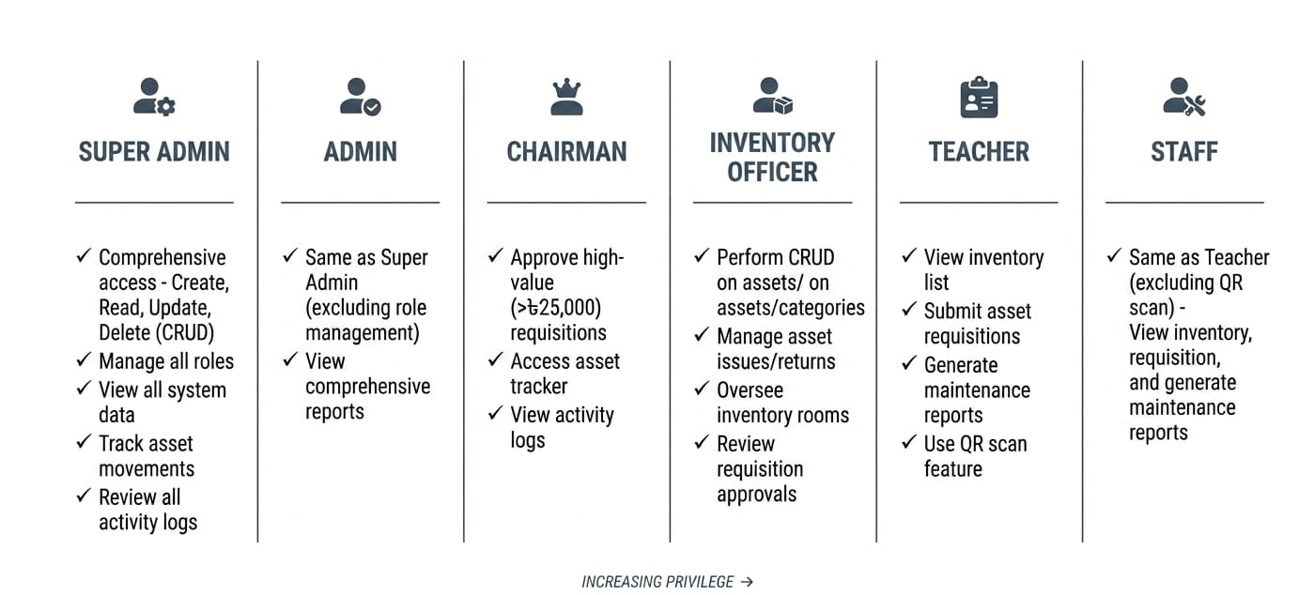
Continue..
Role-Based Access Control — 6 User Roles
Super Admin
1
Admin
2
F
Chairman
3
Inventory Officer
4
Teacher
5
Staff
6

Slide 9
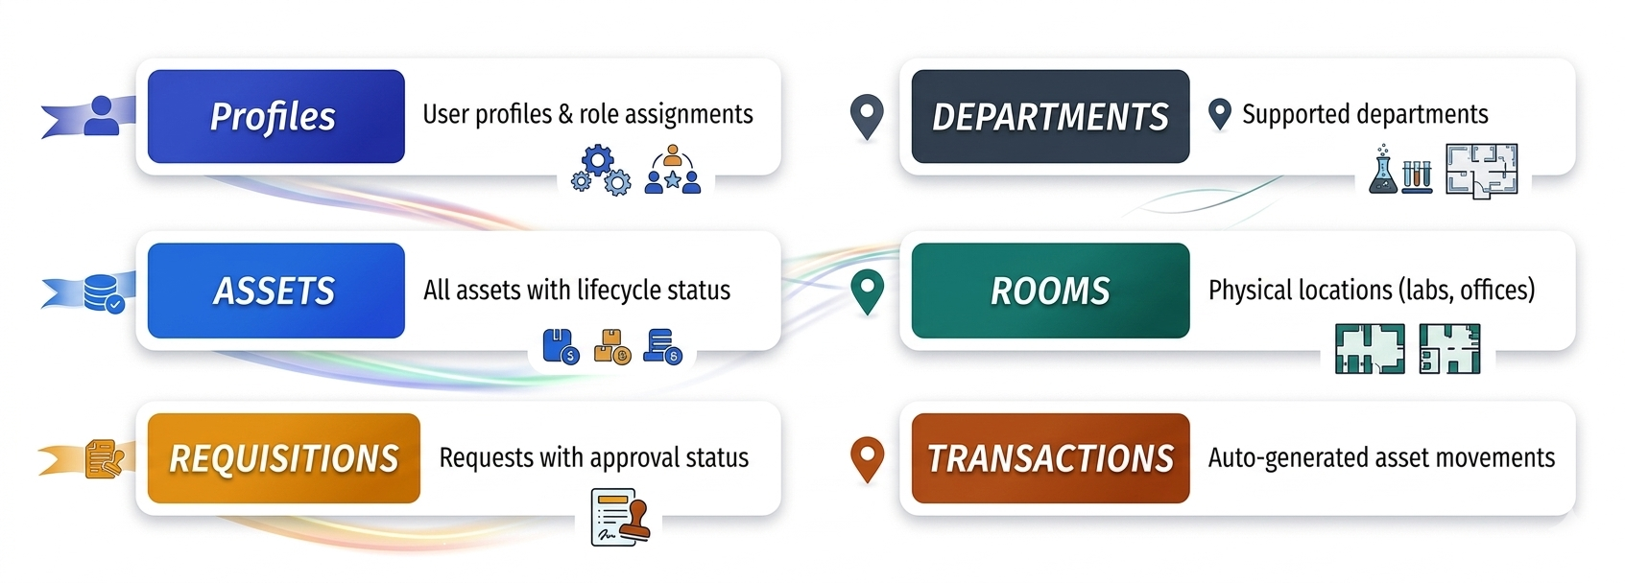
Continue..
Database Schema — 8 Core Entities

Slide 10


Continue..
Requisition Workflow — Two Paths
Standard Flow
Submit Request
Pending Review
IO Approves
Disbursed
HIGH-VALUE FLOW (> BDT 25,000)
Submit
IO Approves
Chairman
Pending
Chairman
Approves
Disbursed
Pending
Chairman Pending
Approved
Rejected
Disbursed
Returned

Slide 11
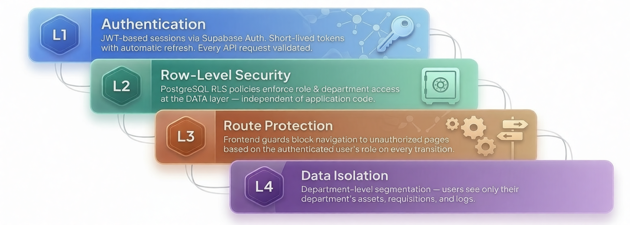
Continue..
Multi-Layer Security Architecture
L4

Slide 12
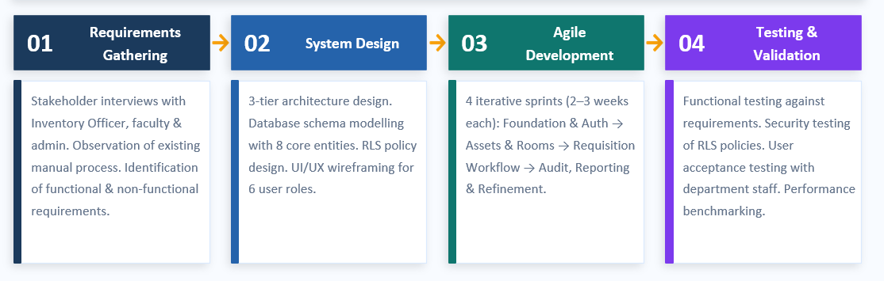
Methodology

Slide 13
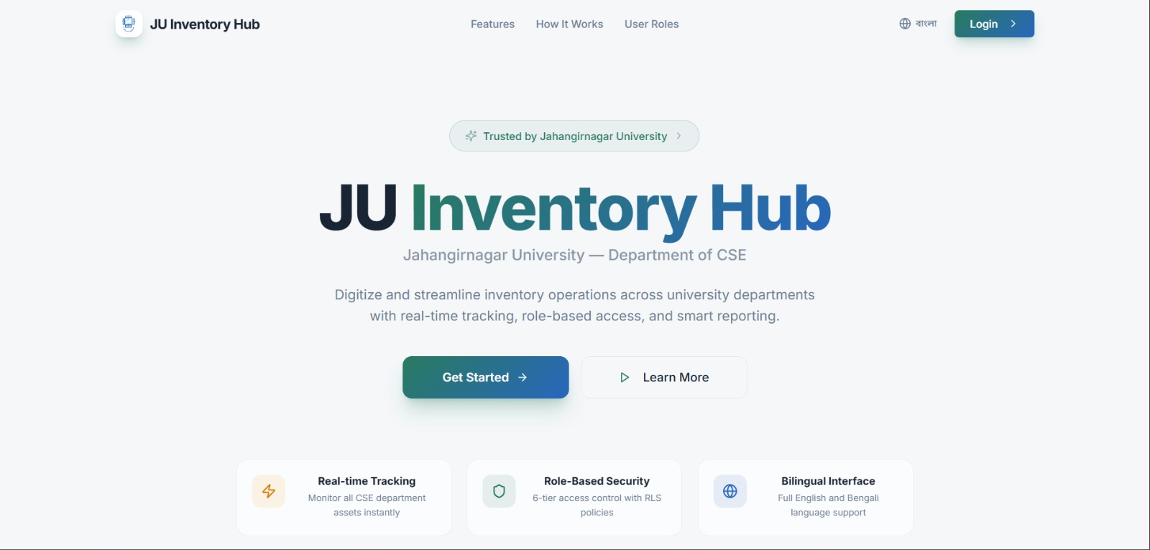
Current status

Slide 14
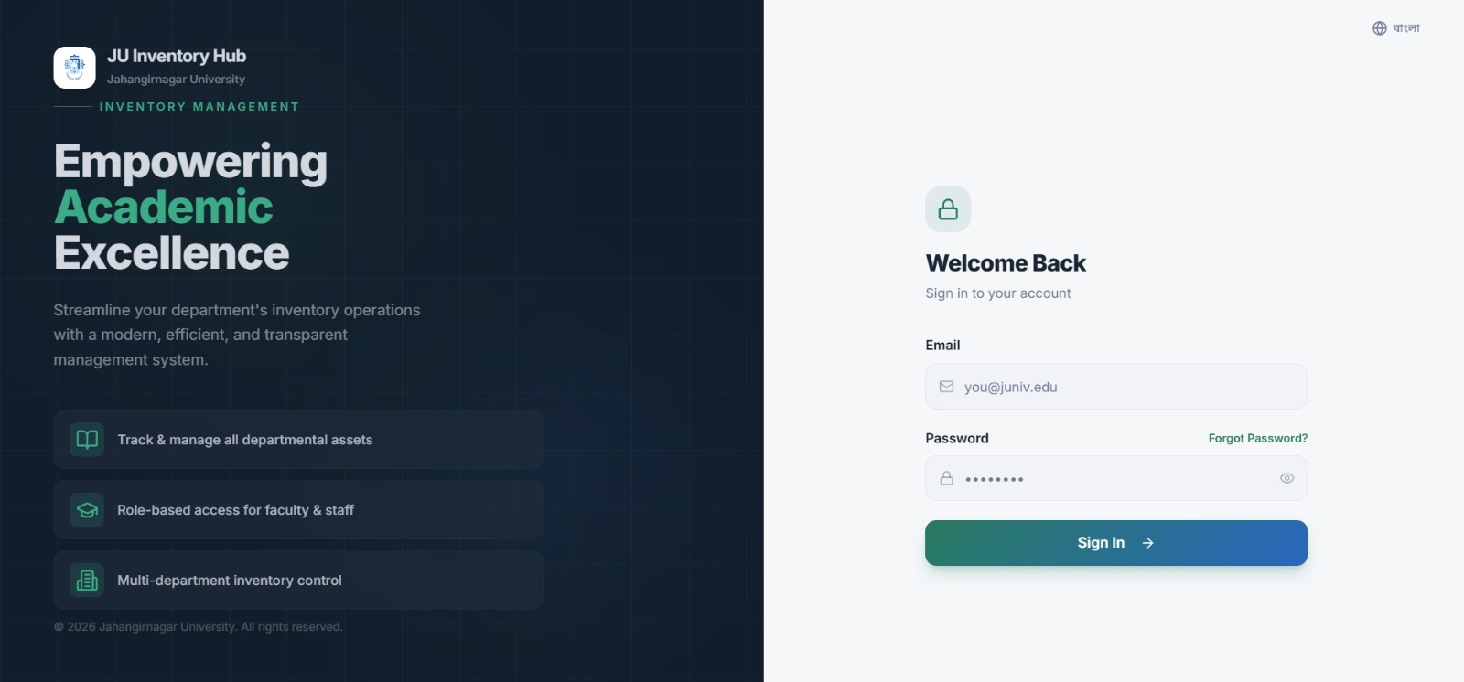
Current status

Slide 15
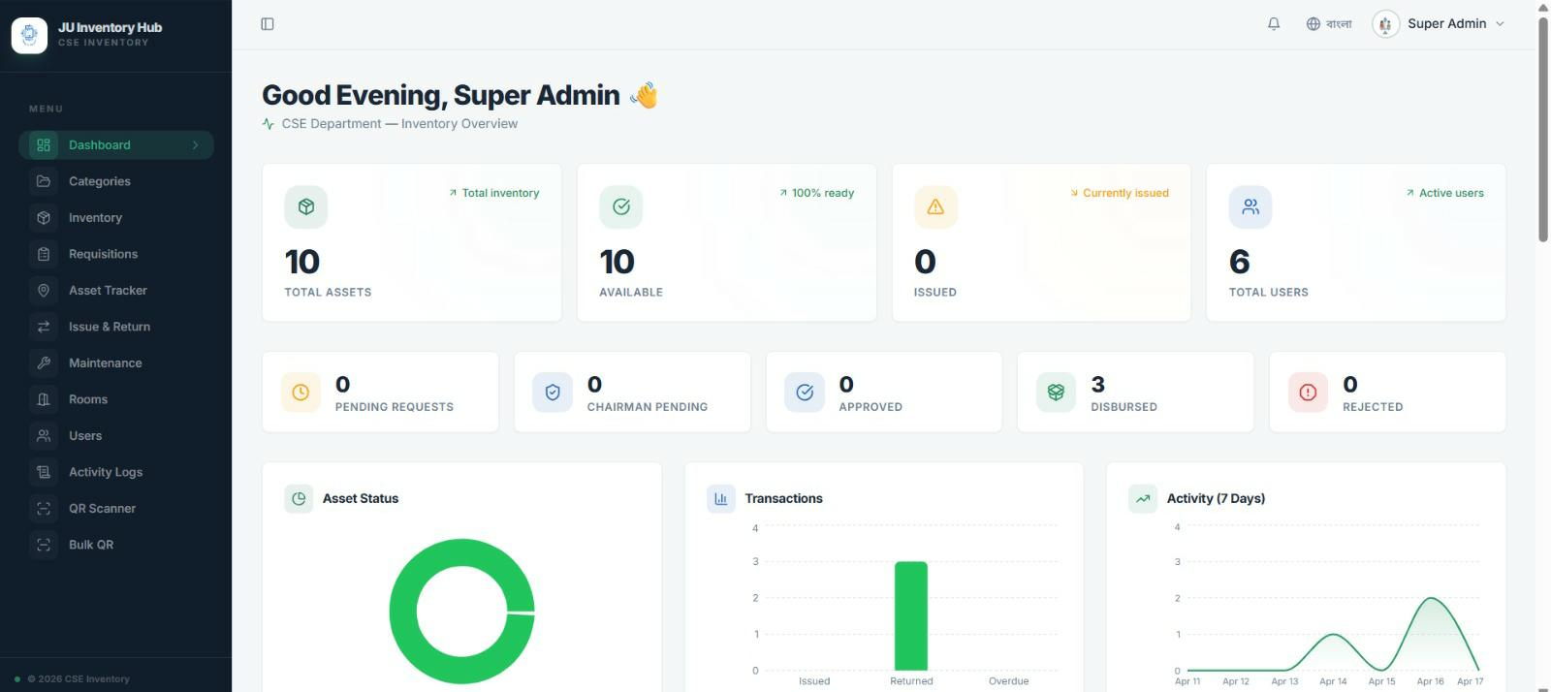
Current status

Slide 16
Contributions & Significance
Practical Contribution: A production-ready solution tailored for the JU CSE department that eliminates paper waste and increases transparency.
Technical Contribution: Demonstrates how modern "Backend-as-a-Service" (BaaS) can be used to build secure, scalable academic tools.
Institutional Impact: Empowers the Chairman with a bird's-eye view of high-value investments and maintenance schedules.
Significance: Reduces the time spent on manual audits by an estimated 70% through digital reporting and QR scanning.

Slide 17
Limitations & Challenges
Connectivity: Currently requires an internet connection for real-time Supabase syncing.
Legacy Data: Digitizing the backlog of existing physical paper records is a time-intensive manual process.
Hardware: Scanning relies on high-quality mobile cameras; low-light environments may present scanning challenges.

Slide 18
Conclusion & Future work
JU Inventory Hub can successfully replaces manual processes with a secure, auditable, and role-based digital system.
Future Work:
Development of a Mobile PWA for offline-ready access.
Predictive AI for stock forecasting and maintenance alerts.
RFID integration for passive asset tracking in labs.
Integration with the central University ERP system.

Slide 19
References
Camu. (2026). Objectives of Inventory Management System and What it is?
Jones, et al. (2023). The Impact of Predictive Analytics on Resource Optimization in Higher Education. Journal of Educational Technology Systems.
Kumar, H. (2024). Utilization of Inventory Management System in Educational Organization. The Academic, 2(10), 39-42.
Smith, B., & Johnson, A. (2021). The Intersection of Technology and Inventory Management in Universities. Educational Operations Review.
Squalio. (2025). Higher Education Inventory Management Made Easy.
Wang, Y., et al. (2021). Streamlining Resource Availability in Higher Education through Digital Systems. Journal of Academic Administration.

Slide 20

Thank You
Any Questions?

