Slide 1
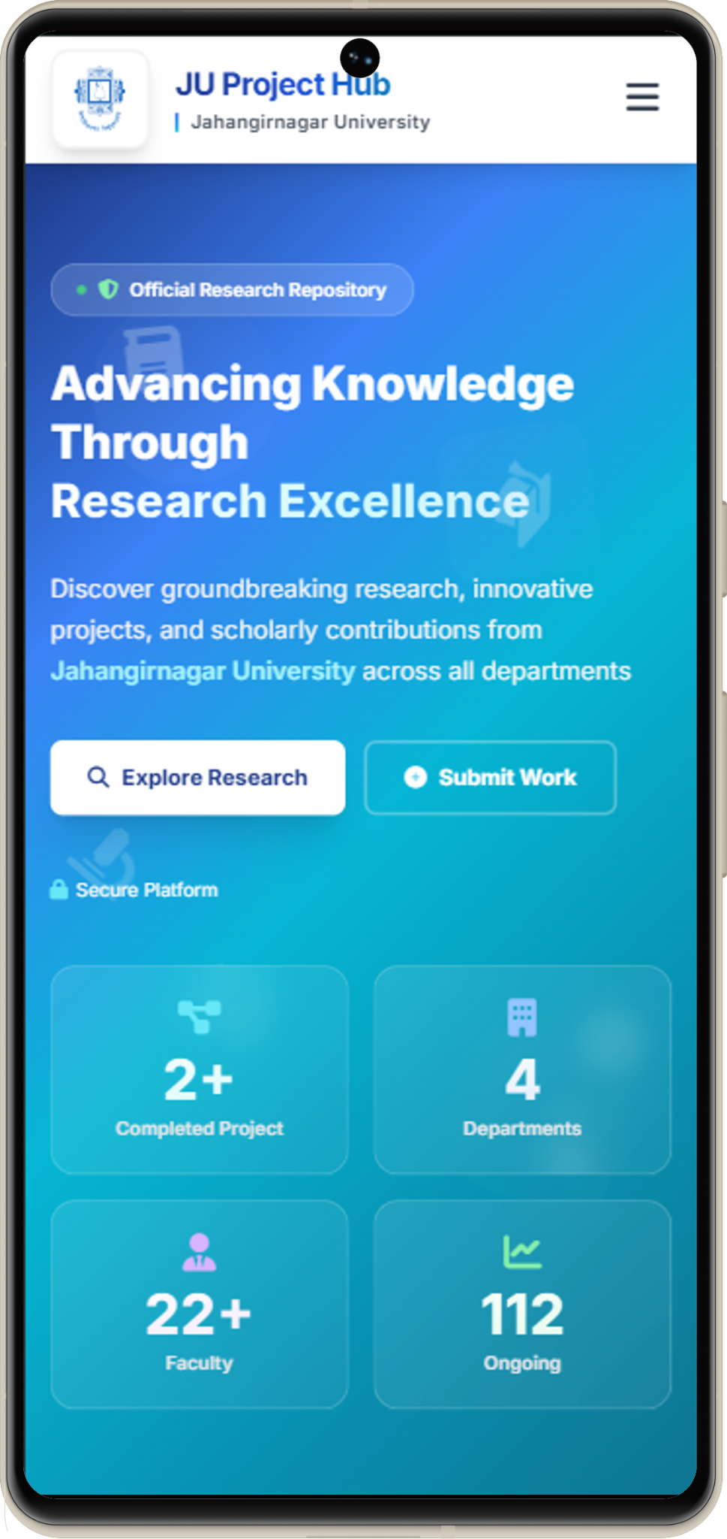
Research Project · Pre-Defense · 2026
Project
Hub
Academic Project & Thesis Management System
A centralized digital platform managing the complete lifecycle of
academic projects and theses — from idea to result declaration.
Md. Khaled Saifullah Sadi
ID: CSE202502128
Batch 38 · PMSCS Program
Dept. of CSE, Jahangirnagar University
18 April 2026

Slide 2
Agenda
What we'll cover in this presentation
01
Introduction
02
Problem Statement
Background, motivation & project scope
The gap in university project management
03
Related Work
04
Proposed Solution
Existing systems, tools & comparison
Project Hub — features, user roles & modules
05
Development Methodology
06
System Design & Architecture
Research design, Agile SDLC & validation strategy
3-tier stack, Use Case, DFD & ER Diagram
07
System Workflow
08
Feature Screenshots
End-to-end project lifecycle & examination process
Live walkthrough of implemented modules
09
Testing, Progress & Challenges
10
Conclusion, Future Work & Refs
Test cases, dev status, limitations & hurdles
Summary, planned enhancements & references

Slide 3





Introduction
Background, motivation, scope and objectives
Background
Graduate project & thesis management in universities relies on informal, fragmented, and manual processes with no centralized digital system.
Project Hub
Motivation
78% of Bangladeshi university supervision uses informal channels. Manual processes cause avg. 1.8 semester delays (Ali & Rahman, 2020).
Academic Project &
Thesis Management System
Scope & Objectives
Design a role-based web platform covering idea submission → milestone tracking → examinations → evaluation → result declaration.
Jahangirnagar University
Dept. of CSE
Expected Contributions
8
3
14
Modules
Roles
FRs
Structured, auditable project workflow for all stakeholders, and a public research portal showcasing departmental academic output.

Slide 4
Problem Statement
Why Project Hub is needed
✕
No Structured Workflow
Idea submission & approval done informally with no tracking
✕
Fragmented Communication
The Core Problem
Students & supervisors rely on informal emails and messages
✕
No Milestone Tracking
University departments lack a
structured digital platform to
manage academic project and
thesis lifecycles effectively.
Project progress and deadlines are scattered and unmonitored
✕
Examination Management Gap
No system for boards, attendance requests or exam scheduling
✕
No Public Research Portal
Departmental research output is invisible to the outside world

Slide 5
Related Work
Existing tools & platforms — what they offer and where they fall short
📌 Existing Tools Analyzed
What it does
Gap / Limitation
🐙 GitHub
🔷 Jira
📋 Trello
Version Control & Project Boards
Project & Task Management
Board Tool
Code hosting, issue tracking, project kanban boards, pull requests and team collaboration for software development.
Sprint planning, task tracking, backlog management, bug tracking and workflow automation for software teams.
Visual boards, card-based task management, simple team collaboration and basic workflow tracking.
✕ No academic supervision model. No idea approval workflow, exam board management, milestone evaluation or result declaration.
✕ No academic role differentiation. No supervisor-student relationship, attendance approval, board evaluation or thesis workflow.
✕ No structured approval chains. No user roles, no exam scheduling, no milestone deadlines, no evaluation or result system.
🎓 Moodle
🖥️ Google Classroom
💬 Microsoft Teams
Learning Management System (LMS)
Assignment & Course Management
Communication & Collaboration
Course management, assignment submission, grade recording and student-teacher interaction within a course context.
Assignment creation, submission, grading and class-level announcements for teacher-student interaction.
Team messaging, video conferencing, file sharing and integrations for organizational communication and collaboration.
✕ Designed for courses, not projects. No thesis supervision flow, milestone tracking, board management or exam scheduling.
✕ No multi-stage project lifecycle. No idea approval, milestone tracking, board creation or public research portal.
✕ Communication only — no structured workflow. No approval chains, evaluation system, exam board or audit trail.
No existing tool offers a complete all-in-one solution for supervisor assignment, idea approval, milestone tracking, board management, evaluation, and public result publishing. Project Hub fills this gap for academic project and thesis management.
Gap Found:

Slide 6






Proposed Solution
Project Hub — a unified digital management platform
Project Hub
A web-based system covering the complete lifecycle: idea → supervision → milestones → examinations → result
Structured Workflow
Communication Hub
Milestone Tracking
Idea submission to final result — all in one place
In-system messaging, observations & document sharing
Define deadlines, track progress, flag overdue tasks
Exam Management
Evaluation System
Public Research Portal
Boards, attendance approval, student assignment
Structured marks & grading across all exam phases
Department projects & abstracts visible to everyone

Slide 7



User Roles
Three stakeholders with distinct responsibilities
Admin
Supervisor
Student
System Authority
Faculty / Teacher
BSc/MSc Candidate
Creates & manages all user accounts
Reviews & approves submitted project ideas
Submits one or more project/thesis ideas
Assigns supervisors to students
Monitors student milestone progress
Updates milestone progress and status
Creates examination boards & assigns students
Approves or rejects exam attendance requests
Uploads observation files & documents
Oversees all project statuses
Participates in final assessment panel
Requests supervisor approval for exams
Declares final results publicly
Provides marks and written observations
Views result on personal dashboard

Slide 8
Key Features
Eight core modules powering Project Hub
01
Supervisor Assignment
02
Idea Submission & Approval
Admin manually assigns a dedicated supervisor to each student at program start
Students submit ideas; supervisor reviews and approves one to begin work
03
Milestone Management
04
Communication & Files
Milestones with deadlines, status tracking and automated overdue alerts
In-platform messaging, observation reports and document upload system
05
Exam Attendance Requests
06
Exam Board Management
Students request supervisor approval before attending any exam
Admin creates boards with Chairman + Members; manual or auto student assign
07
Final Assessment
08
Public Research Portal
Supervisor + one external faculty provide marks for final grade calculation
Open portal showing department projects, abstracts and supervisor stats

Slide 9
Development Methodology
Approach, process model and tools used to build Project Hub
⚙ Development Approach
📊 SDLC Phases
Requirements Analysis
01
✓ Done
🔄
Agile SDLC
— Iterative, sprint-based delivery
User needs, FRs, use cases
🧪
TDD
— Test-Driven Development for core modules
System Design
02
✓ Done
📐
MVC Pattern
— Model-View-Controller architecture
Architecture, DB schema, UI
🗓 Agile Sprint Plan
03
Module Development
70%
Sprints — code & unit tests
Sprint 1–2
Auth, RBAC, User Mgmt
04
Integration Testing
Sprint 3–4
Idea, Milestone, Communication
50%
API & E2E test automation
Sprint 5–6
Exam Scheduling & Board Mgmt
05
UAT & Validation
30%
User acceptance testing
Sprint 7–8
Assessment, Result, Public Portal
06
Deployment & Docs
10%
Deploy, report & handover

Slide 10
System Workflow
Complete project lifecycle — from enrollment to result declaration
1
2
3
4
5
6
7
8
Supervisor
Assigned
Idea
Submission
Idea
Approval
Milestone
Tracking
Pre-Defence
Exam
Defence
Exam
Final
Assessment
Result
Declared
SETUP
▸ Admin creates accounts ▸ Assigns supervisor to each student ▸ System ready for project submission
PROJECT
▸ Student submits ideas ▸ Supervisor reviews and approves one ▸ Work begins on approved topic + milestones
EXAM
▸ Admin schedules Pre-Defence & Defence ▸ Creates board with Chairman + Members ▸ Students attend only after supervisor approval
RESULT
▸ Panel submits final marks independently ▸ Admin reviews aggregated score ▸ Result officially declared & published

Slide 11
Examination Process
Multi-phase examination with board management
ADMIN
1. Creates the examination (Pre-Defence / Defence) with date
PRE-DEFENCE
Intermediate Evaluation
ADMIN
2. Creates an examination board — assigns Chairman and Members
Assesses project progress before the final defence. Board reviews work and gives feedback.
ADMIN
3. Assigns students to board — manually or auto-random
STUDENT
4. Submits attendance request to supervisor for approval
DEFENCE
SUPERVISOR
5. Reviews request — approves or rejects with reason
Final Examination
Formal final examination determining overall project/thesis grade and completion.
BOARD
6. Evaluates students — provides marks and written observations
SYSTEM
7. Aggregates all evaluation marks for final result computation

Slide 12



System Architecture
Three-tier web application design
Presentation Layer
Application Layer
Data Layer
Frontend
Backend API
Database
Vue Js , Html
⇄
PHP, Laravel
⇄
MySQL
Tailwind CSS
REST API Design
Eloquent ORM
Role-based Dashboards
JWT Authentication
File Storage System
Responsive UI
Business Logic
Backup & Recovery
🔐 Security
📱 Responsive
⚡ Performance
📦 Scalable
💾 Reliable
JWT + RBAC
Mobile-first
Fast & concurrent
Multi-Program ready
Backup + recovery

Slide 13
Use Case Diagram
System actors and their interactions with Project Hub
Assign Supervisor
Create Exam Board
Manage Users
Declare Result
Submit Project Idea
Track Milestones
Admin
Upload Documents
Request Exam Attend.
Approve Project Idea
Approve Attendance
Supervisor
Submit Evaluation
View Public Portal
Student
Send Messages
View Results
Project Hub System
Public

Slide 14
Data Flow Diagram (DFD)
Level 0 Context Diagram & Level 1 Process Breakdown
LEVEL 0 — Context
LEVEL 1 — Process Decomposition
Admin
P1
P2
P3
User actions
User
Management
Project Idea
Workflow
Milestone
Tracking
D1 User Store
Project data
Project
Hub
System
D2 Project Store
Student
P4
P5
P6
Communication
& Files
Exam &
Board Mgmt
Evaluation
& Result
D3 Exam Store
Supervisor
D4 Board Store
Evaluations
P7
Public
Portal
D5 Result Store
Public
Public queries
Process
Data Store
External Entity

Slide 15
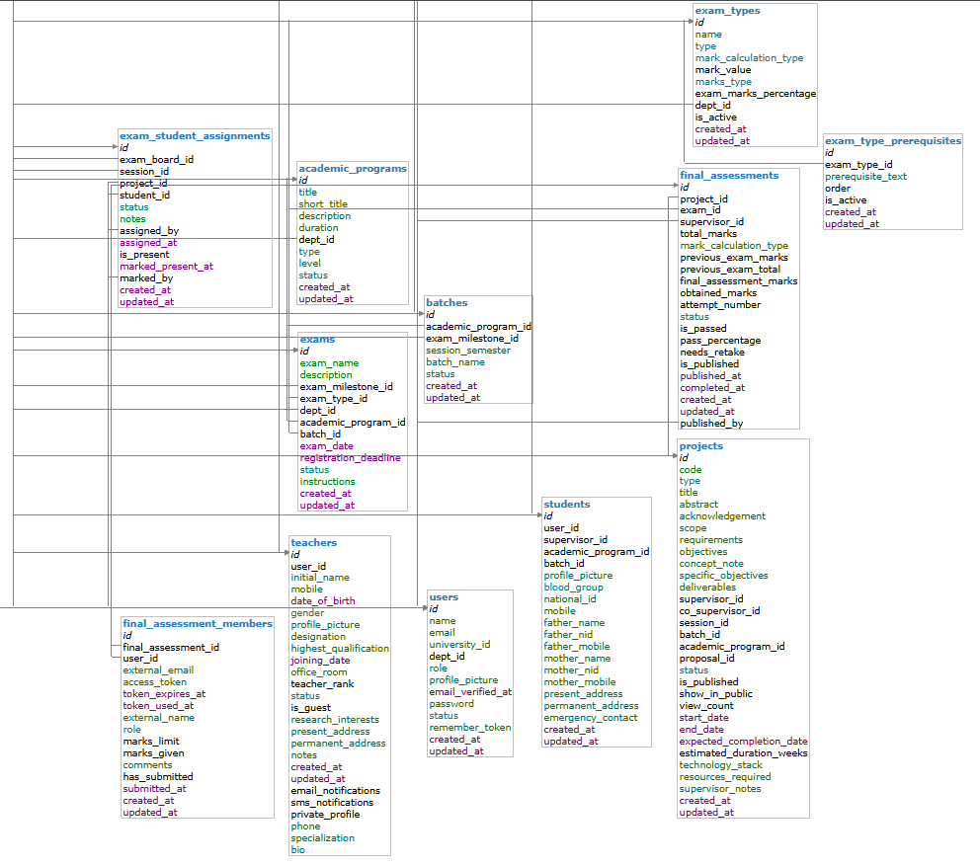
ER Diagram — Entity Relationship
Database entities, attributes and relationships for Project Hub

Slide 16
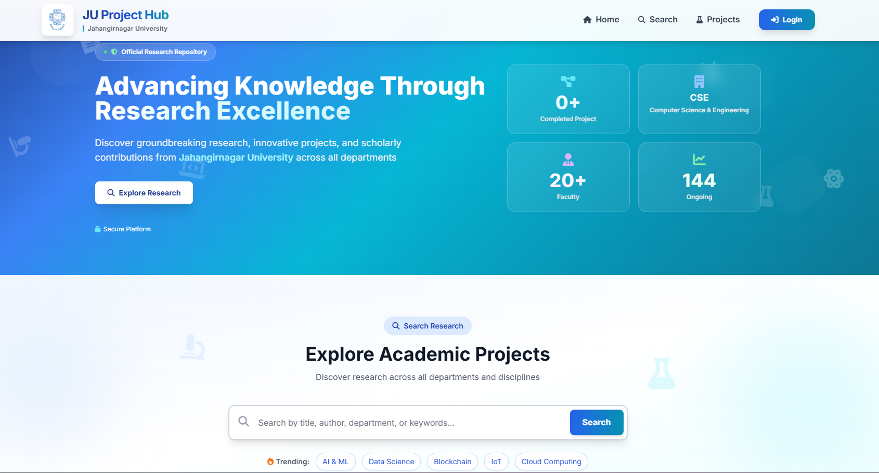
Feature Screenshots
Landing Page
Live walkthrough of implemented modules

Slide 17
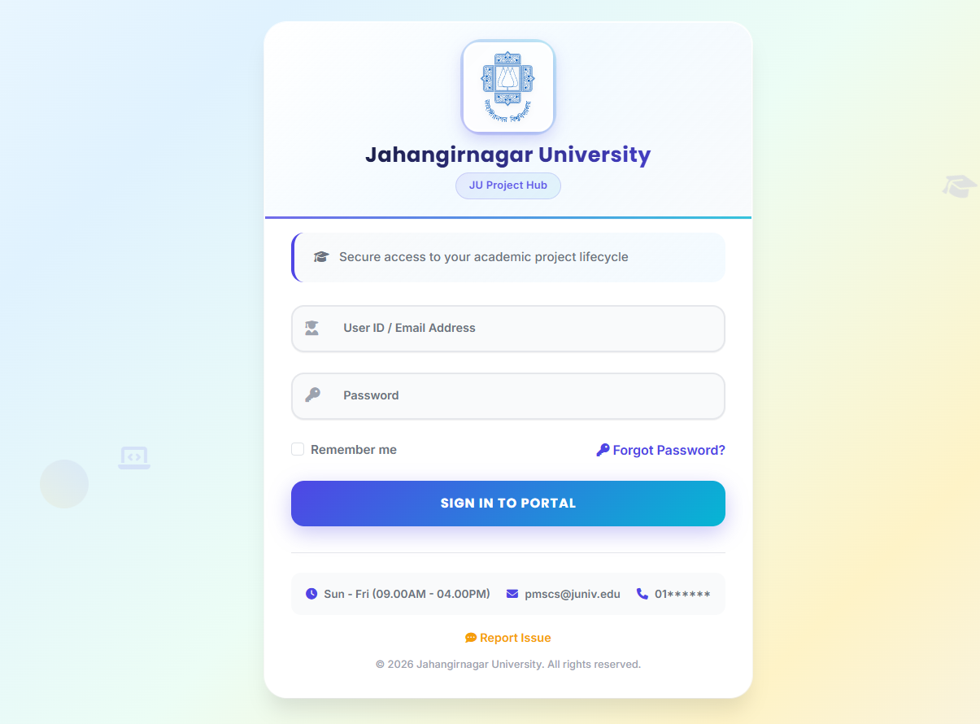
Feature Screenshots
Login Page
Live walkthrough of implemented modules

Slide 18
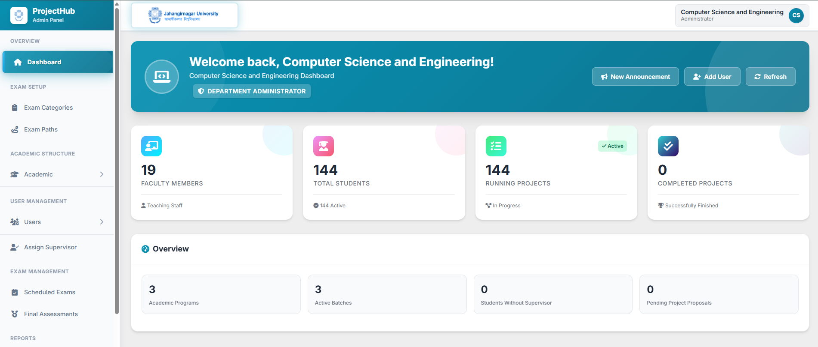
Feature Screenshots
Admin Dashboard
Live walkthrough of implemented modules

Slide 19
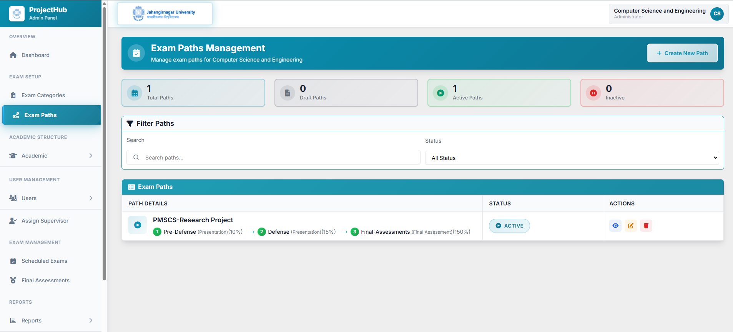
Feature Screenshots
Exam Path Management
Live walkthrough of implemented modules

Slide 20
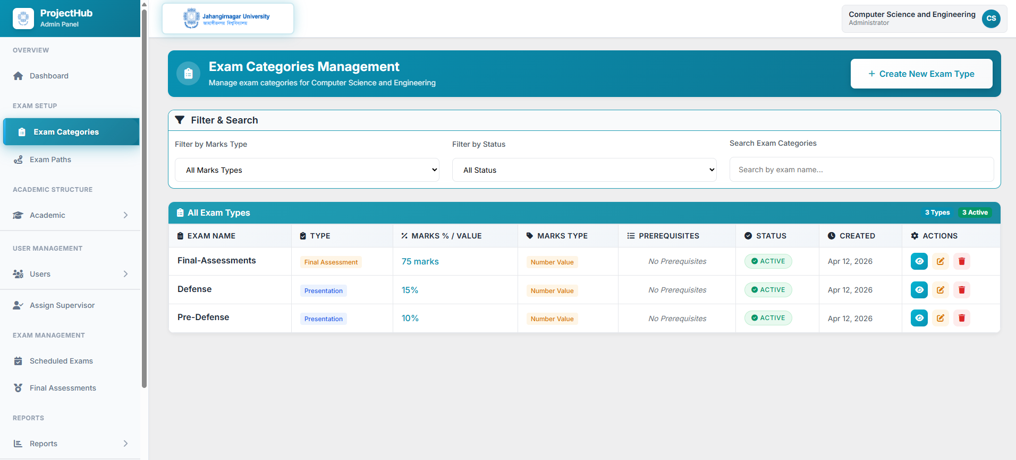
Feature Screenshots
Exam Type
Live walkthrough of implemented modules

Slide 21
Testing Plan — Test Cases
Tools used, test types & functional validation of Project Hub modules
🧪 Testing Tools Used
PHPUnit
UNIT
Pest Feature Test
INTEGRATION
Cypress
AUTOMATION
Postman
API
Unit Testing
Integration Testing
E2E Automation Testing
API / Manual Testing
Tests individual functions, API handlers and business logic in isolation.
Tests REST API endpoints — verifies HTTP status codes & database interactions.
Automates browser-based tests simulating real user journeys for all 3 roles.
Manual validation of all REST API endpoints with different inputs & roles.
📋 Test Cases
ID
Module
Test Case
Tool
Type
Expected Result
Status
TC-01
Auth
Admin login with valid credentials
PHPUnit
Unit
JWT issued, dashboard loaded
✓ Pass
TC-02
Auth
Login rejected with wrong password
PHPUnit
Unit
401 error, access denied
✓ Pass
TC-03
RBAC
Student tries admin route directly
Pest PHP
Integration
403 Forbidden returned
✓ Pass
TC-04
Supervisor
Admin assigns supervisor to student
Pest PHP
Integration
Saved, both parties notified
✓ Pass
TC-05
Idea
Student submits project idea via form
Cypress
E2E
Idea stored, supervisor notified
✓ Pass
TC-06
Idea
Supervisor approves idea from dashboard
Cypress
E2E
Project status → Active
✓ Pass
TC-07
Milestone
Student updates milestone to Completed
Postman
API
Status updated, supervisor sees change
✓ Pass

Slide 22
Project Progress
Current development status by module
Requirements Analysis & Documentation
100%
System Design & Architecture
100%
Database Schema Design
85%
Authentication & User Management
80%
20%
70% Overall
Project Idea & Milestone Module
70%
Progress
Communication & File Upload Module
60%
Examination & Board Management
55%
Final Assessment & Public Portal
20%
Complete
In Progress
Active
Started

Slide 23
Challenges & Solutions
Key technical and design hurdles overcome
Challenge
Solution
!
Complex Role-Based Access Control
➜
✓
Implemented JWT middleware with RBAC — each role accesses only its permitted routes and data
Challenge
Solution
!
Multi-Step Examination Workflow
➜
✓
Designed a stateful workflow engine with defined states (Pending → Approved → Attended) and a full audit trail
Challenge
Solution
!
Auto-Random Board Assignment
➜
✓
Built a fair distribution algorithm balancing student load per board member with conflict-of-interest rules
Challenge
Solution
!
Real-time Status Notifications
➜
✓
Event-driven notification system alerts users of approvals, rejections, and deadlines without page reload

Slide 24
Limitations
Current system constraints and their impact on the study
01
Single-Department Deployment
02
No Real-Time Notifications
03
No Native Mobile Application
The current implementation is configured for the CSE department at Jahangirnagar University only. Multi-department support is architecturally designed but not yet deployed in v1.
The current system uses polling-based notification checks. WebSocket-based real-time push notifications have not yet been implemented in this version.
Project Hub is accessible via mobile browsers through responsive web design, but no dedicated native application exists for Android or iOS platforms currently.
Impact:
Does not affect core workflow correctness; multi-dept support is a planned roadmap item.
Impact:
May cause slight delays in notification delivery; core approval workflow functions correctly.
Impact:
Users can access full functionality via mobile browser; native app is a future work item.
04
No Automated Plagiarism Detection
05
Limited Analytics Dashboard
Document originality verification is not automated. Supervisors must manually review submitted project documents for originality during the supervision process.
Version 1 provides basic status overviews without advanced analytics such as trend analysis, bottleneck identification, or predictive milestone risk assessment.
Impact:
Manual review is feasible given current student loads; API integration is planned for v2.
Impact:
Core tracking and management functions are fully available; analytics is a future enhancement.

Slide 25
Conclusion & Future Work
Summary and what comes next
🎯 Conclusion
🚀 Future Work
Digitalizes the complete academic project & thesis management lifecycle
📱
Mobile application (Android & iOS)
Eliminates communication gaps across all stakeholders
🤖
AI-powered supervisor-student matching
🔍
Automated plagiarism detection system
Provides structured, transparent workflow from idea to result
📧
Email & SMS notification integration
Public research portal promotes department research output
📊
Analytics dashboard for department heads
Extensible to other departments and programs in future
🏫
Multi-university support and expansion

Slide 26
References
Academic sources cited in this research
2019
Ahmed, S., Islam, M. R., & Hossain, M. A.
Challenges in graduate thesis supervision in Bangladeshi universities. Journal of Higher Education Research Bangladesh, 7(2), 45–62.
2012
Al-Omari, A., Rawashdeh, A., & Al-Qeisi, K.
Role-based access control in university information systems. International Journal of Computer Science and Information Security, 10(4), 112–119.
2020
Ali, M., & Rahman, K.
Digital transformation in Bangladeshi higher education: A gap analysis. Bangladesh Journal of Educational Technology, 4(1), 18–34.
2021
Daoust, N., Beauchamp, C., & Gauthier, J.
Digital workflows in academic supervision: Efficiency and satisfaction outcomes. Higher Education Management and Policy, 33(1), 97–115.
Git,Jira,Moodle etc
Project management

Slide 27
Thank You
Questions & Answers
Open for questions from the board

