Slide 1
iProject : A personal project tracker
Research Project Pre-Defense
Student Id: CSE202502145
Name: Md Mahthiul Hasan Thanvi
Intake: Summer 2025
Presenter
Notes:
NOTE:
To change the image on this slide, select the picture and delete it. Then click the Pictures icon in the placeholder to insert your own image.

Slide 2
Content
Introduction
Related Work
Problem Statement
Objectives
Conceptual Framework
Methodology
Feature Screenshots
System Architecture & Design
Data Flow Diagram(DFD)
Contributions & Significance
Limitations & Challenges
Conclusion & Recommendations
Future Work
References
Q&A / Thank You Slide

Slide 3
Introduction
Hundreds of university students engage in significant research projects each semester.
Effective communication is crucial among students, instructors, department heads, and institutional administrators.
Current management of this workflow is challenging, leading to missed deadlines and delayed feedback.
The data used to evaluate departmental performance is fragmented.
A new technology has been developed to digitize and streamline this process into one secure, real-time interface.

Slide 4
Related Work
Generic Task Managers (Trello, Asana): Built for corporate teams, completely lacking the strict, multi-tiered hierarchy required by universities.Key theories, models, or frameworks
Legacy Systems (Spreadsheets & Email): Highly prone to data fragmentation. Feedback is easily lost, and version control for thesis documents is nearly impossible.Highlight the limitation of existing works
Jira: Built for corporate development, forcing academia to use complex agile terminology while lacking out-of-the-box, secure departmental data isolation.
GitHub: Designed specifically for software version control, making it overly technical for non-engineering departments and lacking the specific supervisory grading hierarchies required for academia.

Slide 5
Problem Statement
Administrative Bottlenecks: Managing hundreds of students causes severe workflow delays.
Loss of Data: Feedback, document versions, and project milestones are easily lost in email threads.
Lack of Oversight: Department and Institute heads have no real-time visibility into student progress or faculty workload.
The Gap: The stringent, multi-tiered Role-Based Access Control (RBAC) and data isolation (multi-tenancy) that academic institutions expressly demand are absent from current project management software.
The Need: A dedicated, centralized platform engineered to mirror the exact academic hierarchy (Admin>Institute> Department> Teacher >Student) to ensure secure, efficient, and transparent project tracking.

Slide 6
Objectives
Develop a secure, multi-tenant architecture.
Implement 6 distinct user roles (Super Admin, Admin, Institute Admin, Dept Admin, Teacher, Student).
Provide real-time milestone tracking and analytics.

Slide 7
Conceptual Framework
Role-Based Access Control (RBAC): Ensuring users only interact with data relevant to their specific clearance level.
Multi-Tenancy: Allowing multiple independent institutes to operate on the same software instance securely.
Relational Database Mapping: Utilizing One-to-Many cascading relationships (Institute -> Department -> Teacher -> Student).

Slide 8
Methodology
Development Approach: Agile software development.
Tech Stack: PHP, Laravel (MVC architecture), and relational database design.
System Design: Wireframing user dashboards, defining Eloquent relationships, and setting up middleware for role verification.

Slide 9
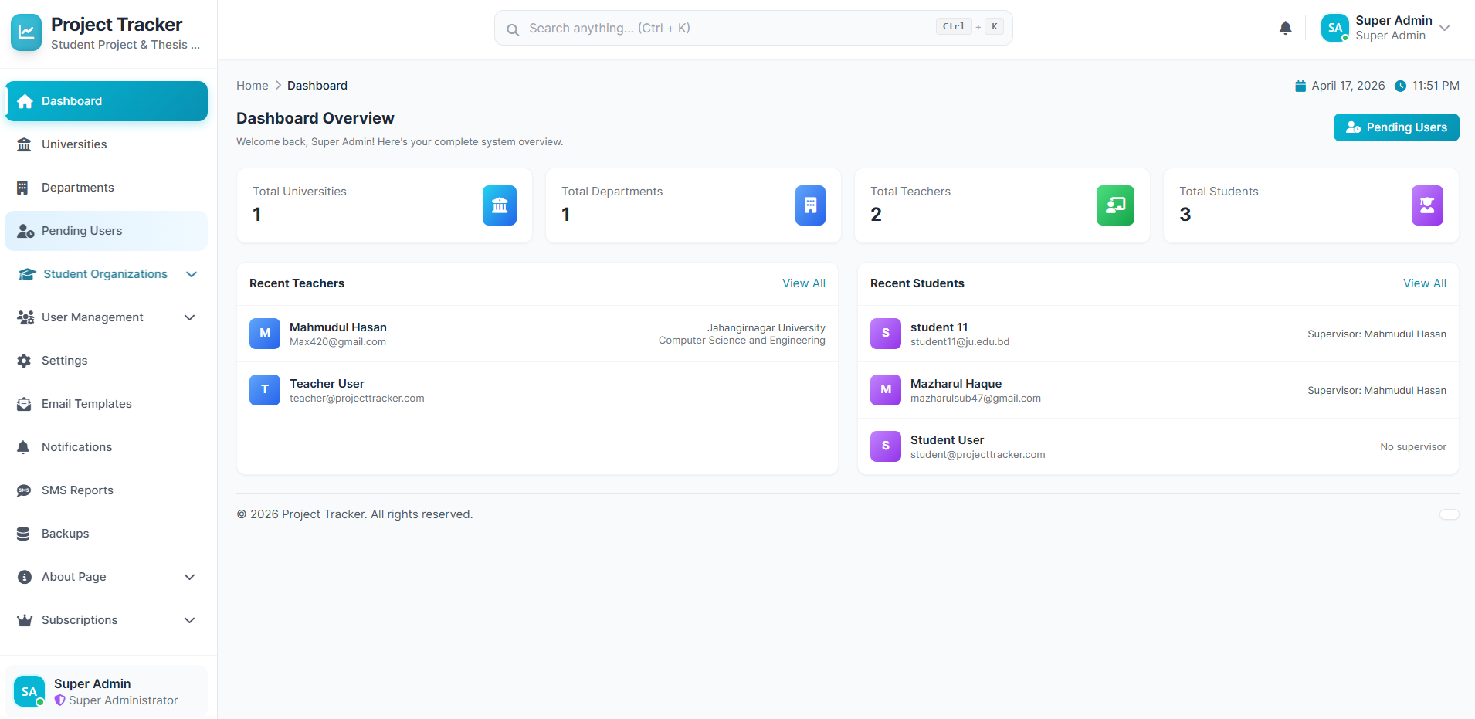
Feature Screenshots
Fig : Admin dashboard

Slide 10
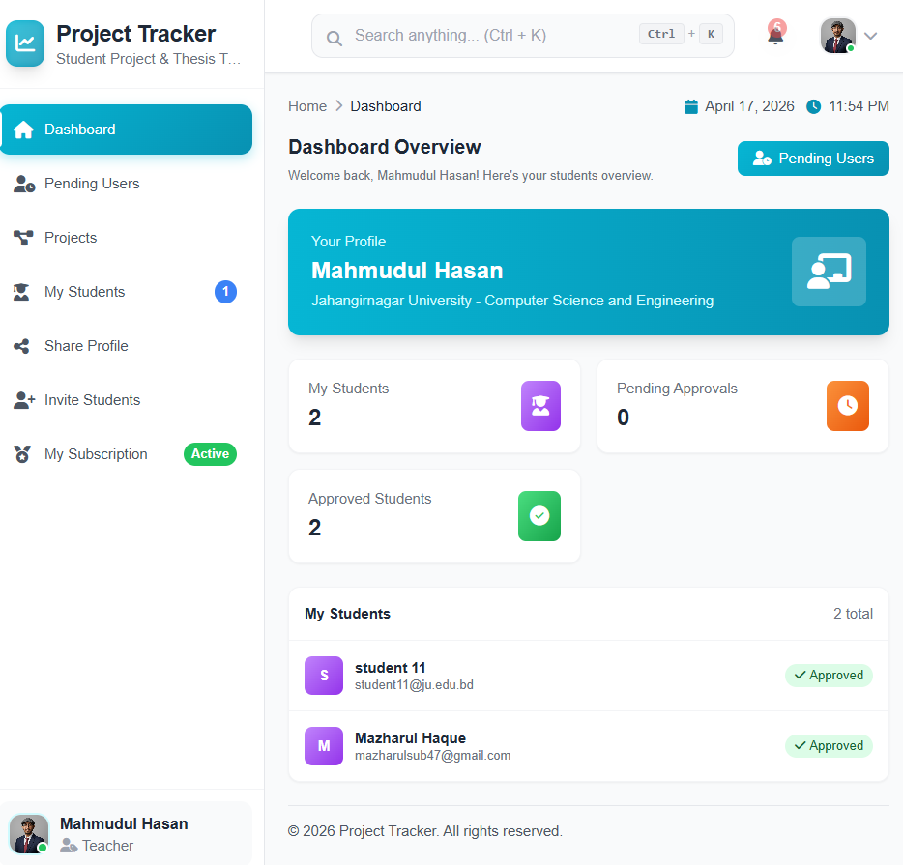
Feature Screenshots
Fig : Teacher dashboard

Slide 11
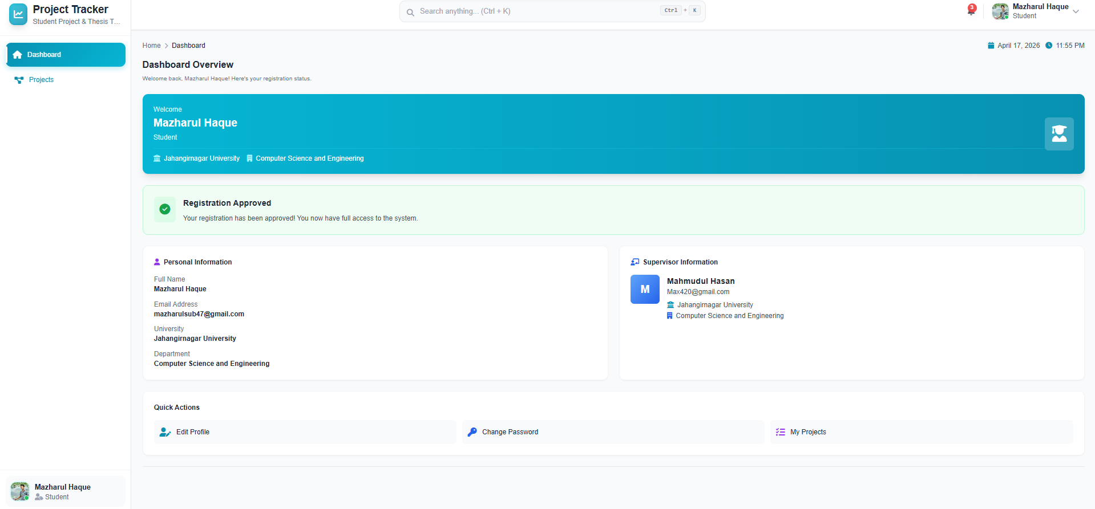
Feature Screenshots
Fig : Student dashboard

Slide 12
System architecture & design
Architecture Pattern: Model-View-Controller (MVC) utilized through the Laravel framework.
Frontend Interface: Responsive web design handling distinct dashboards for all 6 user roles.
Backend Logic: PHP handling routing, authentication, and business logic.
Security Layer: Custom middleware to enforce strict role-based access and data isolation between departments.

Slide 13
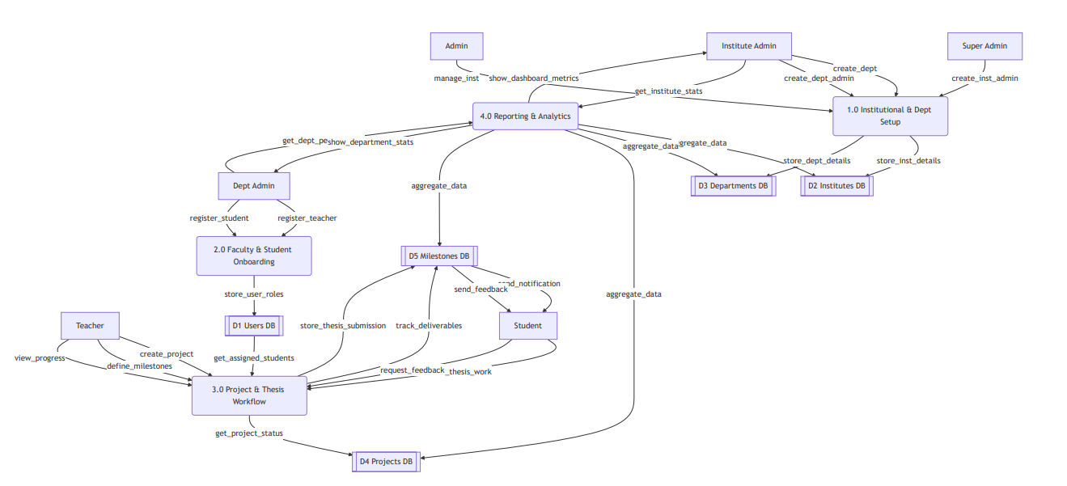
Data Flow Diagram (DFD)
Findings from experiments, surveys, or data analysis
Graphs, Charts, or Statistical Results
Comparison with Hypothesis/Research Questions

Slide 14
Contributions & Significance
For Teachers: Eliminates email clutter; provides a clear overview of all supervised students.
For Admins: Generates instant, high-level reports on department performance.
For Institutions: Digitizes the entire thesis workflow, making it 100% secure and accessible 24/7.

Slide 15
Limitations & Challenges
Lack of Third-Party Integrations: The platform currently operates as a standalone system and does not yet integrate with existing Learning Management Systems (LMS) like Moodle or Canvas.
Manual Verification: The system relies on Teachers to manually review and approve milestones; it lacks automated checks like built-in plagiarism detection (e.g., Turnitin API).

Slide 16
Limitations & Challenges
Complex Middleware Logic: Designing a foolproof 6-tier Role-Based Access Control (RBAC) system in Laravel required highly complex middleware to prevent permission overlap.
Strict Data Isolation: Ensuring true multi-tenancy—where a Department Admin cannot accidentally query or view another department’s thesis data—was a significant database engineering hurdle.
UI/UX Balancing: Creating distinct, intuitive dashboards for 6 entirely different user roles without making the platform feel cluttered.

Slide 17
Conclusion & Recommendations
Conclusion: The Project Tracking Management System successfully bridges the gap between general task managers and academic requirements.
Recommendations: Institutions should adopt centralized iProject systems to ensure data continuity, academic integrity, and better student outcomes.

Slide 18
Future Work
System Integration: Extending the platform via REST APIs to sync seamlessly with existing Learning Management Systems (LMS) like Moodle or Canvas.
Automated Integrity Checks: Integrating third-party APIs (like Turnitin) to automatically scan thesis document submissions for plagiarism.
Mobile Ecosystem: Developing a dedicated mobile application for iOS and Android to provide real-time push notifications for deadlines and faculty feedback.

Slide 19
References
Books & Journals:
Sandhu, R. S., Coyne, E. J., Feinstein, H. L., & Youman, C. E. (1996). Role-based access control models. IEEE Computer, 29(2), 38-47. (Standard academic citation for RBAC)
Stauffer, M. (2019). Laravel: Up & Running: A Framework for Building Modern PHP Apps (2nd ed.). O'Reilly Media.
Chong, F., & Carraro, G. (2006). Architecture strategies for catching the long tail. Microsoft Corporation. (Classic paper on multi-tenant architecture)
Online Sources:
Laravel (2024). Laravel Documentation: Eloquent ORM and Middleware. Retrieved from https://laravel.com/docs
Spatie (2024). Laravel-permission Documentation. Retrieved from https://spatie.be/docs/laravel-permission (If you used a package for your roles)
Draw.io / Mermaid.js (2024). Diagramming Tools for ER and DFD System Architecture.

Slide 20

Q&A / Thank You
iProject : A Personal Project Tracker
Notes:
iProject : A Personal Project Tracker

